Slide 1
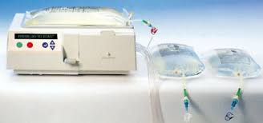
APD
Automated Peritoneal Dialysis

Slide 2
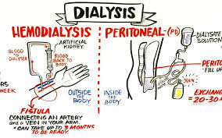
Type of Dialysis which uses the peritoneum in a person abdomen as the membrane through which fluid and dissolved substance are exchange with the blood . It is use to remove excess fluid, correct electrolyte problems and remove toxins in those with kidney failure.

Slide 3

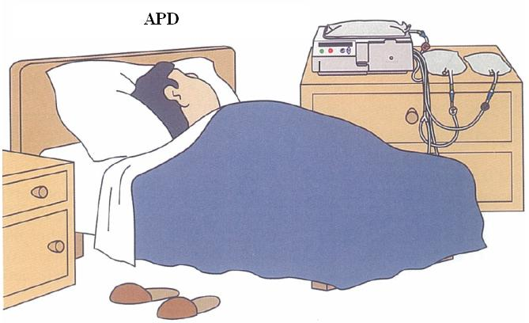
Tow types of PD:
Peritoneal dialysis (PD) can be performed either manually as in continuous ambulatory peritoneal dialysis (CAPD) or using mechanical devices as in automated PD (APD).
Continuous ambulatory peritoneal dialysis (CAPD) – where the blood is filtered several times during the day. the patient empties a fresh bag of dialysis solution into the abdomen. After 4 to 6 hours of dwell time, the patient returns the solution containing wastes to the bag.
Automated peritoneal dialysis (APD) – where a machine helps filter the blood during the night sleep.
APD has been considered to have several advantages over CAPD such as reduced incidence of peritonitis, mechanical complications and greater psychosocial acceptability.

Slide 4
PD fluids:
Is a tool use by Nephrologist to determine the characteristic of peritoneal membrane mass transport characteristic when assessing a patient for peritoneal dialysis.
The peritoneal equilibration test—often called the PET—measures how much dextrose has been absorbed from a bag of infused dialysis solution and how much urea and creatinine have entered into the solution during a 4-hour dwell. The peritoneal transport rate varies from person to person. People who have a high rate of transport absorb dextrose from the dialysis solution quickly, and they should be given a dialysis schedule that avoids exchanges with a long dwell time because they tend to absorb too much dextrose and dialysis solution from such exchanges.
Dianeal 1.36% Dextrose
2.26% Dextrose
3.86% Dextrose
Extraneal 7.5% Dextrose

Slide 5
Peritonitis
is an inflammation of the peritoneum, the tissue that lines the inner wall of the abdomen and covers and supports most of the abdominal organs. Peritonitis is usually caused by infection from bacteria or fungi.
Signs and symptoms :
Abdominal tenderness or distention
Chills
Sever Abdomen pain Septic Shock
Fever
Fluid in the abdomen
Not passing any urine, or passing significantly less urine than usual
Vomiting
Diagnosis:
Physical Examination( redness /discharge and swelling of the site
Imaging studies such as X-rays
PD fluid sample.
Treatment:
Antibiotic
Pain management
Correction of Electrolytes

Slide 6
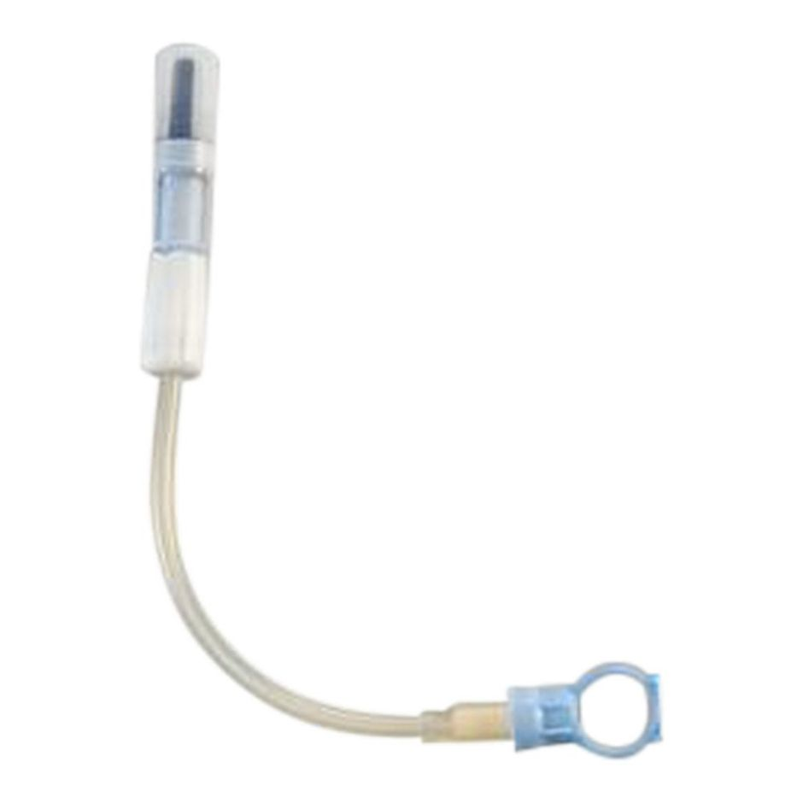
Prevention of Infection:
Change transfer set every 6 month,
Daily sterile dressing
Application of antibiotic ointment
Flushing once per week.

Slide 7
Heparin
PD catheter Flushing :
Newly inserted catheter
Blockage
Once per week
Infection ( Peritonitis) 10-20ml/kg 3-4times
Constipation
Catheter not in place

Slide 8
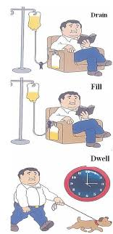
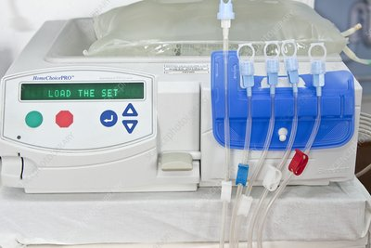
APD Process :
Total volume =NO of Cycles *Fill Volume
Fill Volume Dwell Time Drain
Fill 1 of 25
First Cycle Total of Cycle

Slide 9
APD Trouble shouting:
1.Low drain ( Need to press red button then green button )
Reasons
*Constipation need to give child laxatives
*peritonitis need to flush the PD catheter ( sometimes need to heplock transfer set for 1Hr if no benefit to use Reteplase) and to treat the peritonitis.
*PD catheter king
*PD catheter not in the place
Negative UF ( Need to press red button then green button)
Reasons
*Continuously alarming of low drain need to neguf
*Peritonitis because of poor UF and low drain because of fibrin
***If the child want to go to the toilet or X- ray and he is on APD
Need to stop the dialysis during only dwell time( the fluid inside the abdomen) by pressing red button
Wear mask and apron
Hand washing, hand rub
Open sterile gauze, new mini cap , micropore

Slide 10
5. Disconnected from the patient and put new mini cap and over with 2pieces of sterile gauze and patient line to cover with 5 pieces of sterile gauze and to keep it in the cassette place.
6. When the patient finish, to connect to patient after that to press green button.
***If the patient in the HD , started on APD and they want to shift child to the ward
1. To stop only during dwell time
2. Close patient line clamp
3. Switch off the machine
4. Keep the machine on patient bed
5. Transfer the patient
6. To switch on the machine, it will show power restore then to press red button
7. Open patient clump.
*** If the machine show continuously alarm low drain, neguf
To do manual drain ( need to press red button to stop dialysis and to go arrow and to search for manual drain and to press conform button near arrow)
After manual drain the machine will show drain stop then to press bypass to go for next cycle
Need to make sure all fluid came out then to do bypass.

Slide 11
Thank you

